Slide 1
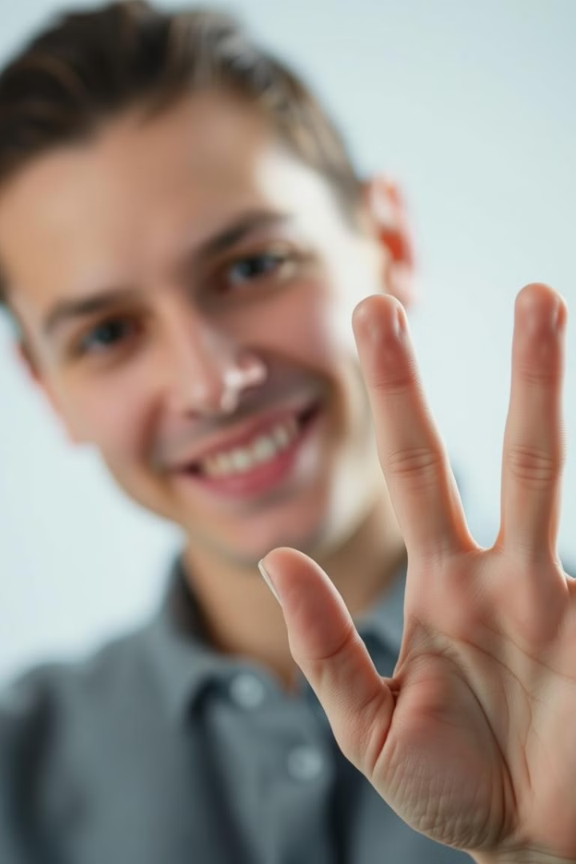
Bridging Worlds: Sign Language to Speech
Exploring the intersection of human gestures, sign language, and speech recognition.
Team:GenxAI

Slide 2
Decoding Gestures: The Language of Movement
Visual Communication
Cultural Significance
Beyond Words
Expressing ideas through hand movements.
Unique sign languages across communities.
Emotions conveyed through facial expressions.

Slide 3
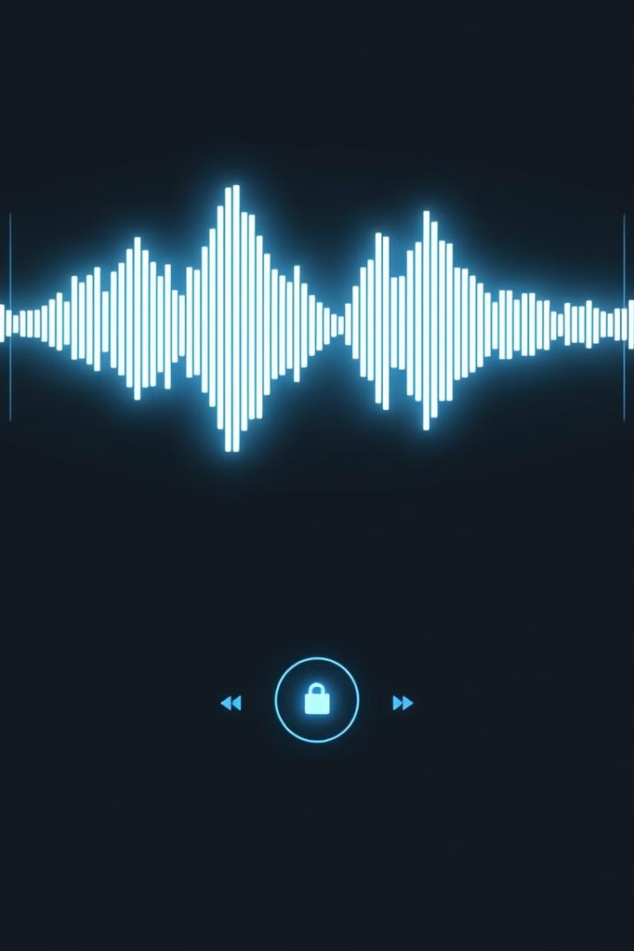
Speech Recognition Technology
1
From Sound to Text
2
Machine Learning
Analyzing spoken words and transcribing.
Training models for accurate recognition.
3
Real-time Translation
Enabling instant communication across languages.

Slide 4
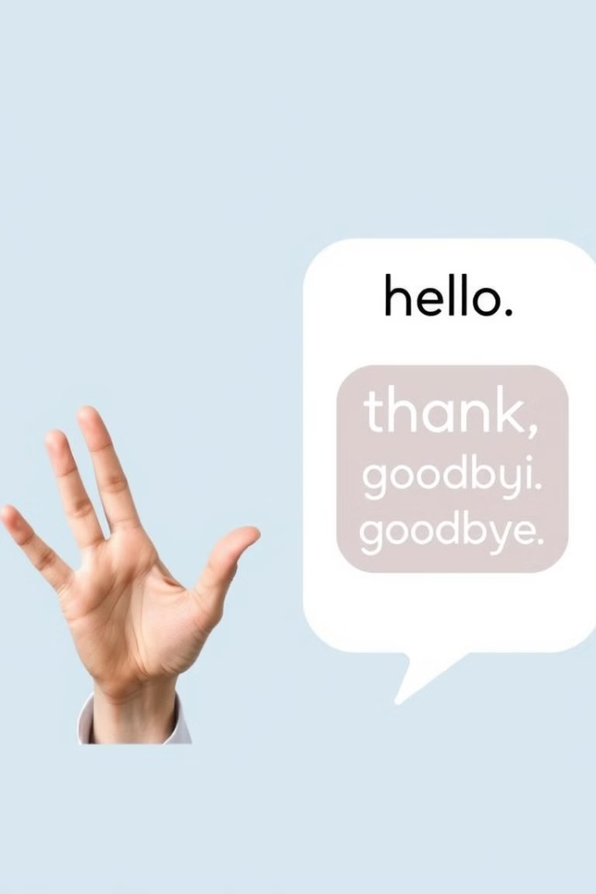



The Process: Sign to Speech
Gesture Capture
Translation
Speech Synthesis

Slide 5
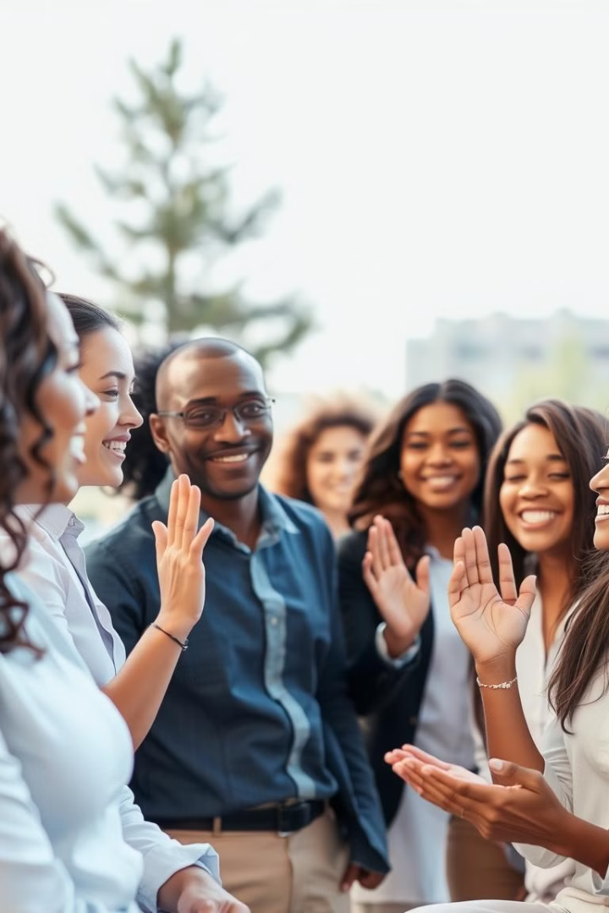



Applications and Impact
Accessibility
Education
Communication
Empowering communication for deaf.
Enhancing learning and knowledge sharing.
Breaking down communication barriers.

Slide 6
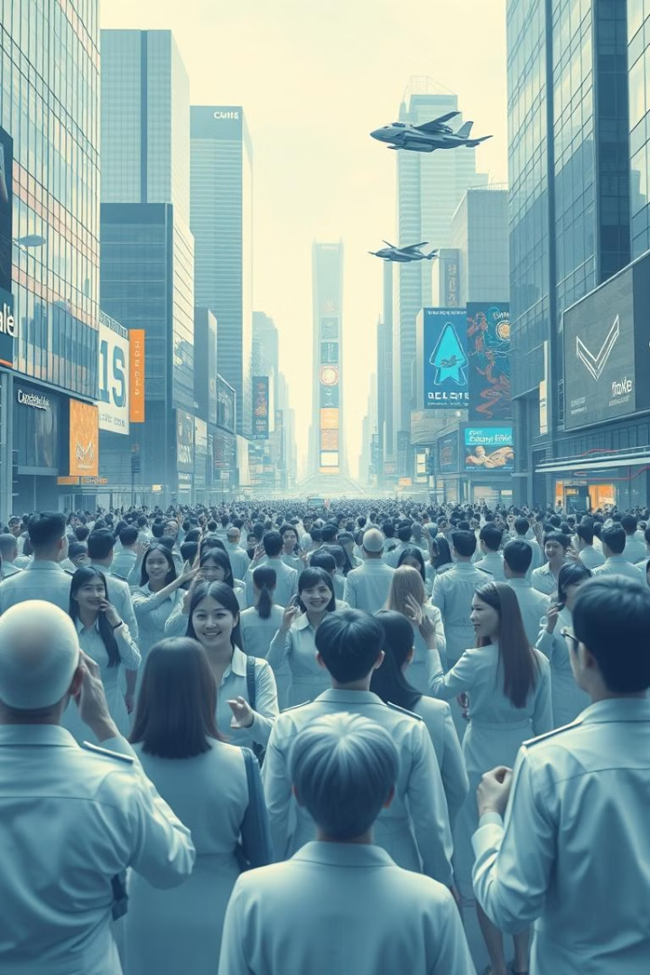
Future Directions and Call to Action
Improved Accuracy
Wider Adoption
Continuous learning and optimization.
Integrating tech across daily life.
Inclusivity
Gesture Recognition:
Building a world with equal communication.
The ability to standardize gestures across different cultures and languages

Slide 7
THANK YOU

